Slide 1

Clawing Back Executive Compensation
James Ang
Yingmei Cheng
Sarah Fulmer

Slide 2

Notes:
What is the Dodd-Frank Clawback? In 2010 Congress passed the Dodd-Frank Wall Street Reform and Consumer Protection Act in response to the financial institution failures and subsequent bailout. In addition to financial overhaul, a section of Dodd-Frank focuses on corporate governance and executive compensation (951: “Say on Pay” 952: Comp committee independence; 953: Disclosures and ratios). We focus on Section 954: Recovery of Erroneously Paid Compensation, more commonly referred to as a “clawback”. The concept of a clawback is not new – congress passed Section 304 of SOX in 2002; Reg S-K in 2006 (required firms to disclose clawback policy, if they had one).
What is a clawack? If executive receives compensation that he did not earn, the SEC (SOX) or Board (Dodd-Frank) can recover the amount of overpayment – the amount that was not earned. Important: Clawbacks apply to incentive compensation, not fixed salary.

Slide 3
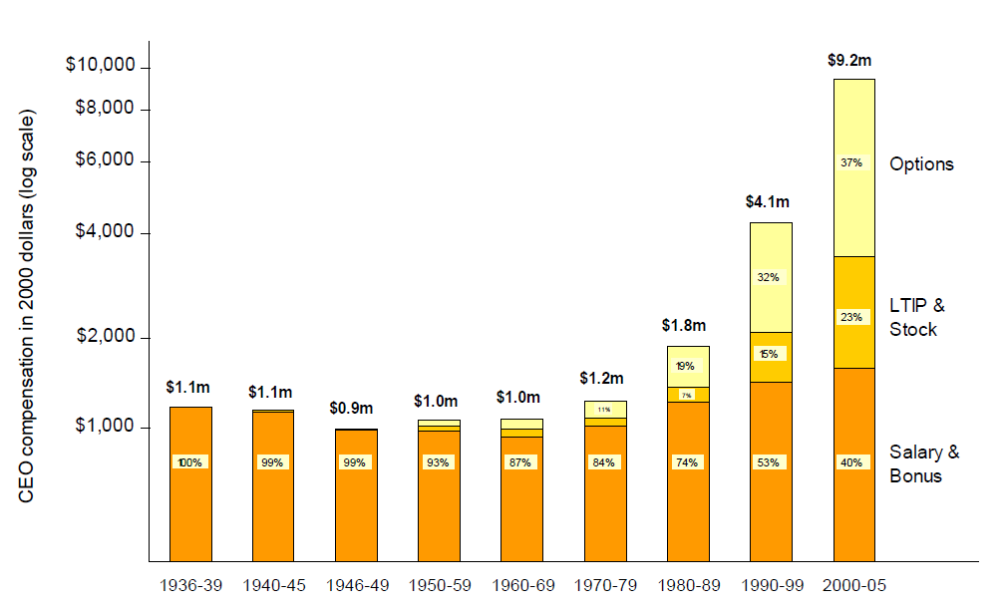
Source: Frydman and Jenter (2010) CEO Compensation, Working paper
Notes:
Why is the Clawback important? In 1976, Jensen and Meckling (Theory of the Firm) proposed using incentive compensation (specifically equity) to align management interest with shareholders. Since then, executive pay has grown drastically (from roughly 42 time the average worker pay in 1980s to 343 times in 2010). As shown in graph, incentive compensation now accounts for OVER 60% of total compensation (60% equity plus whatever portion is bonus).

Slide 4
Agency Problem
Incentive compensation aligns management interest with shareholders – Mehran (1995); Jensen and Murphy (1990)
Incentive compensation, particularly stock options, encourages management to manipulate earnings – Klinger et al. (2002)

Slide 5
CEO | Company | Restatement Period | Total Incentive Compensation | Stock / Option Profits
Bernie Ebbers | MCI (WorldCom) | 1999-2002; $69.9 billion | $100 million | $430 million “loan” for stock
Maurice Greenberg | AIG | 2000-2005; $3.4 billion | $121.7 million
Richard Scrushy | HealthSouth | 1996-2002; $2.6 billion | $259 million | $74 million
William McGuire | United Health | 1994-2005; $1.5 billion | $246.3 million | $390 million
Paul Allaire | Zerox | 1997-2000; $1.4 billion | $41.6 million | $35.3 million
Sanjay Kumar | Computer Associates | 1999-2000; $2.2 billion | $30.7 million
Joseph Nacchio | Qwest Communications | 2000-2001; $2.5 billion | $76.4 million | $52 million
Notes:
Why is this a problem? When compensation is tied to firm performance it may encourage management to manipulate earnings in effort to boost their “incentive” compensation.
Examples of CEOS and restatements in our sample. While these are extreme examples, it does illustrate the seriousness of earnings manipulation and the importance in having an effective clawback policy.
MCI: The adjustments resulted in a cumulative net reduction . . . in previously reported net income attributable to common shareholders of $17.1 billion and $53.1 billion for the years ended December 31, 2001 and 2000, respectively (MCI 2002 Annual Report; SEC EDGAR).
NOTE: All numbers have been verified through SEC filngs (10-k, DEF 14A, Insider Tradings, AAERs), DOJ filings (www.justice.gov),

Slide 6
Solutions to Agency Problem
Monitoring by the Board of Directors
  The greater the CEO power, the less effective the Board monitoring – Hermalin and Weisbach (1998)
  Board monitoring weakens over the CEO’s tenure – Ryan et al. (2009)
  Directors have an incentive to appease management – Bebchuck and Fried (2003)
Shareholder Activism / Shareholder Litigation
  Shareholder activism is generally ineffective in changing corporate policy – Romano (2003); Klein and Zur (2009); Admati and Pfleiderer (2009)
Government Intervention / Clawback Provisions
  SOX Section 304
  Dodd-Frank Section 954

Slide 7
Overview of Clawbacks
Contractual or Statutory provision that allows a firm to recover fraudulently or erroneously paid compensation
SOX 304
  requires “misconduct” to trigger clawback
  ALL incentive compensation AND profits from the sale of stock and options for 12 months following misstatement
Dodd-Frank 954
  All exchange-listed firms must adopt Clawback Policies
  Applies to all “material” restatements (does not require misconduct)
  Only recovers “excess” incentive compensation
  Does not apply to recover profits from sale of stock and options

Slide 9
Incentives to Manipulate
Earnings manipulation is more prevalent where CEOs are “incentivized” – Bergstresser and Philippon (2006)
Executives exercise “unusually large” amount of options and sell large amounts of stock during periods of misreporting – Erickson et al. (2006)
Executives manipulate earnings to maintain stock prices or to prevent price decreases – Efendi et al. (2007); Johnson et al. (2008).
Executives manipulate: (a) to prevent decline in earnings; (b) to avoid missing analyst forecasts; and (c) to avoid reporting negative earnings – Burgstahler and Dichev (1997)
CEOs at poorly performing firms are more likely to be terminated – Warner et al. (1988); Arthuad-Day et al. (2006)
Notes:
Earnings management and manipulation have been studied extensively in finance and accounting. The findings indicate that executives manipulate earning for personal gain – either to profit monetarily or to keep their jobs.

Slide 10
Hypothesis Development
H1: The amount recoverable under Dodd-Frank will not be economically significant
H2: CEOs manipulate earnings to profit from stock sales and option exercises
H3: CEOs manipulate earnings to avoid termination
Notes:
Dodd-Frank clawback, as written, applies only to the “excess” incentive compensation and does not apply to the profit from the sale of stock and option exercise. As we show, the gain from stock and options is more than 200 times the amount of “excess” incentive compensation. We therefore predict that any amount recoverable under Dodd-Frank will likely not be economically significant.

Slide 11
Current Incentive Compensation
Firms engage in more manipulation where executives are “incentivized” – Bergstresser and Philippon (2006)
The more Equity / Total Compensation, the greater probability of accounting fraud – Erickson et al. (2006)
Notes:
B & P find that CEOS whose overall compensation is closely tied to stock returns (such as stock and option grants) are more aggressive in the use of discretionary accruals.
Erickson et al. use a logit model and find positive coefficient between incentive compensation (Bonus and Equity) and accounting fraud.

Slide 12
Enforcement of Clawbacks
Firms that voluntarily adopt clawback provisions have better financial reporting quality (deHaan et al., 2012) and lower probability of future restatement (Chan er al., 2011; Chen et al., 2012)
No evidence of enforcement, even in firms that voluntarily adopt clawback provision- Addy et al. (2011); Babenko et al. (2012)

Slide 13
Hypothesis Development
H1: The amount recoverable under Dodd-Frank will not be economically significant
H2: CEOs manipulate earnings to profit from stock sales and option exercises
H3: CEOs manipulate earnings to avoid termination

Slide 14
Stock and Option Profits
Insiders sell more stock during misreported period – Summers and Sweeney (1998); Beneish (1999); Beneish and Vargus (2002); Agrawal and Cooper (2006)
CEOs exercise more options during misreported periods – Kedia and Philippon (2009); Burns and Kedia (2008); Efendi et al. (2007)
Greater earnings management in years the CEO exercises options – Bergstressor and Philippon (2006)
Notes:
Burns and Kedia (2006) find that CEOs sell more stock and options during the misreported periods; Kedia and Philippon (2009) find that compared to non-restatement matched firms, CEOs of restatement firms exercise "significantly higher" fraction of their options than non-restatement CEOs. Efendi (2007) finds compared to matched control firms, CEOs at firms with severe restatement exercised $7.7 million in options, compared to $436,000 at non-restatement firms. These studies are consistent with CEOs having the knowledge that prices are artificially inflated, and that subsequent revelation of the manipulation will cause a correction.

Slide 15
Hypothesis Development
H1: The amount recoverable under Dodd-Frank will not be economically significant
H2: CEOs realize economically significant indirect gains from the sale of previously awarded stock and option grants
H3: CEOs receive indirect benefits from manipulating earnings by reducing their risk of being terminated

Slide 16
Probability of Termination
CEO turnover increases following poor firms performance – Huson et al. (2001)
CEOs who fail to meet analysts expectations face a higher risk of termination – Farrell and Whidbee (2003)
51% of CEOs are terminated within two years following a restatement – Desai et al. (2006)
93% of executives are terminated following SEC investigations for fraud – Karpoff et al. (2008)
Notes:
The first two papers indicate that executives have a strong incentive to make sure they “hit their numbers”, even if it requires manipulation. * Huson, Parrino, and Stark (2001) use industry-adjusted accounting performance (ROA); change in accounting performance; and industry-adjusted stock performance.
The second two articles examine the consequence following an earnings restatement. Clearly there are negative consequences to the CEOs when earnings fall short of expectations.

Slide 17
Summary of Results
H1: Effectiveness of Dodd-Frank
  Can recover something from 93% of the CEOs
  Potential to recover 73% of Direct Gains (i.e. “excess incentive compensation”)
    Economically small amount – average dollar amount recoverable $153,00 per CEO, per fiscal year
    The remaining 27% of Direct Gains are paid more than three years prior to restatement; thus are unreachable under Dodd-Frank
  Capture less than 1% of total gain from manipulation (Direct and Indirect Gains)

Slide 18
Summary of Results
H2: Gains from Insider Trading
  Average CEO earns $3.7 million in stock gain and $3.8 million in option gains (per CEO, per year)
  Average CEO profits by nearly $18 million during the misreported period
H3: Probability of Termination
  18% of the sample are able to reduce their probability of termination by at least 10%
  11% of the sample are able to reduce their probability of termination by at least 50% as result of inflation.
  Thus “survival” is a credible motive.

Slide 19
Sample Selection
Notes:
Use Audit Analytics rather than GAO reports. Includes date of restatement announcement, period restated, cumulative change in net income (missing for many), reason for restatement.
* We use Reason to identify high concern restatements (i.e. “material non-compliance”): those due to fraud, revenue recognition problems, and liabilities / accruals failures.
If a restatement is only quarterly (did not affect annual report; thus compensation decisions) we exclude.
CRSP for stock returns; execucomp for compensation data. Compustat for firm financials (scaling)
* Need to have both restated and unrestated data. To our knowledge, there is no database that includes restated financial data. Therefore we use annual reports from SEC EDGAR. (1) Original 10-k for unrestated data and (2) First 10-k following restatement announcement.
Not all firms file electronically. We lose 7 firms that do not appear in EDGAR at all; 19 firms that either did not file amended 10-k or only mention restatement in footnote without tables; and 28 firms that do not have original 10-k in EDGAR.
211 restatements for 195 firms. Some firms restated (non-overlapping) more than once in our sample.
195 firms with 576 firm-year obs (approx. 3 years per firm, though some as low as one year and as high as 9 years);
195 firms with 245 CEOs: several firms had more than one CEO during restatement period; some as many as three (though typically the longer restatements).

Slide 20
Data
Compensation Data – Execucomp
Financial Data – 10-k Reports (SEC EDGAR)
Termination Data – Lexis-Nexis Searches
  Parrino (1997) Methodology
Stock and Option Data – Thomson Reuter’s Insider Filing Database
Notes:
* Turnovers identified by change in CEOs in Execucomp (all CEOs). Then perform search off news articles to identify the reason for turnover.
* if “ousted” or similar termination-related phrases then code as FIRED;
* if retirement with succession plan or announced at least 6 months in advance then FIRED = 0;
* spontaneous retirements researched more carefully.
* death and health reasons = voluntary (FIRED = 0)
* if unable to identify a reason then leave as missing.
Stock and Option Data: Thomsons Reuters. Identifies the transaction date, Sale Price (for stock; exercise price for options); number of shares (options).
* Estimate Basis for stock: take rolling average of stock purchases over prior 5 years (# Shares * Price). Use as estimated basis.
- Many shares are from restricted stock, which has previously been included as income for share price at grant date. * Stock Gain = (Diff between Sale Price and Est. Basis) x # Shares
* Option Gains = (Diff between Mkt Price and Ex. Price) x # Shares
* Share and option gain calculated by transaction; aggregated by fiscal year.
* Hand-match to ensure stock and option gains are attributed to same CEO (in case CEO changes during fiscal year)

Slide 21
Descriptive Statistics
Notes:
Restatement firms have significantly higher sales than matched firms

Slide 22
Descriptive Statistics
Notes:
Yet have lower net income (unrestated) than matched firms.

Slide 23
Descriptive Statistics
Notes:
Also, the average magnitude of the restatement is $180.4 million (PER YEAR; Unrestated less Restated). Consistent with hypothesis that management is aware of earnings shortfall, so inflate earnings to be closer to industry peers.

Slide 24
Descriptive Statistics
Notes:
No significant difference in Age, Tenure, Salary, or Bonus.

Slide 25
Descriptive Statistics
Notes:
We do see significant difference in incentive compensation (other than bonus). On average, CEOs at restatement firms earn $200k more in LTIP; $1.5m more in Equity; and $1.8m more in Total Comp than matched peers.

Slide 26
Results
Effectiveness of Dodd-Frank
  Direct Gains (i.e. “Excess Incentive Compensation”)
Stock and Option Gains
Probability of Termination

Slide 27
Direct Gains
CEOs are rewarded for positive performance and shielded from negative performance – Gaver and Gaver (1998)
  Examine positive and negative performance variables separately
Cash Incentive = α + β₁Log(Assets) + β₂NI_Pos + β₃NI_Neg + ε
Equity Incentive = α + β₁Log(Assets) + β₂Ret_Pos + β₃Ret_Neg + ε
Notes:
NI_Neg and Ret_Neg are strictly negative by construction
No controls, since would be cancelled out between Restated – Unrestated. Using controls does not change overall results (board controls; CEO ownership; duality; interlock, etc)

Slide 28
Notes:
NOTE: NI_Neg is strictly negative by construction; positive coefficient x negative variable = decrease in compensation
Cash Incentive is positively related to NI_Pos – positive net income increases cash-based incentive pay (Bonus).
Positive relationship with NI_Neg – indicates that negative net income does decrease cash-based incentive pay (Bonus). However much smaller magnitude

Slide 29
Notes:
Positive stock returns (Ret_Pos) does increase Equity-based incentive Comp; Ret_Neg decreases, but by approx 1/3 magnitude.

Slide 30
Direct Gains
Dodd-Frank Section 954:
“in excess of what would have been paid to the executive
officer under the accounting restatement”
Direct Gain (i.e. “Excess Incentive Comp.”) = Unrestated Compensation – Restated Compensation
Methodology: Apply regression coefficients to estimate “Unrestated” Compensation and “Restated” Compensation
  “Restated” stock returns based on what price would have been absent manipulation
    Johnson et al. (2008) find stock prices drop 14.9% upon disclosure of fraud;
    Desai et al. (2006); Palmrose (2004); Kedia and Philippon (2009) find 3-day market returns of -10% to -11% upon restatement announcement;
    Burk (2010) finds 1-day decline of 5.5%.
    Lower Bound = 5%; Upper Bound = 15%
Notes:
How much of compensation is attributable to inflated numbers less how much they would have received if reported correctly.
We observe both restated and unrestated net income
We estimate “restated” stock returns using the upper (15%) and lower (5%) bounds.

Slide 31
Direct Gains
Methodology: Apply regression coefficients to estimate (1) “Unrestated” Compensation and (2) “Restated” Compensation
“Direct Cash Gain” = Cash-Based Incentive_{Unrestated} – Cash-Based Incentive_{Restated}
α + β₁Log(Assets) + [β₂NI_{U}_Pos + β₃NI_{U}_Neg] – [β₂NI_{R}_Pos + β₃NI_{R}_Neg] + ε
“Direct Equity Gain” = Equity-Based Incentive_{Unrestated} – Equity-Based Incentive_{Restated}
α + β₁Log(Assets) + [β₂Ret_{U}_Pos + β₃Ret_{U}_Neg] – [β₂Ret_{R}_Pos + β₃Ret_{R}_Neg] + ε
Notes:
We hold firm size constant (i.e. unrestated total assets). Take difference of incentive compensation under originally reported net income less incentive compensation under correct (restated) numbers. Difference is “Excess Incentive Compensation”

Slide 32
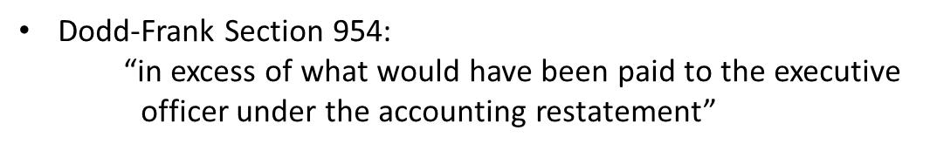
Current Incentive Compensation
Notes:
Average decline in net income of $180 million per fiscal year);
Yet positive excess compensation. All statistically, but not economically, significant. ALTHOUGH at least some CEOs manipulate enough to receive $23.5 million in direct cash gain.

Slide 33
Current Incentive Compensation
SOX Section 304:
“any bonus or other incentive-based or equity-based
compensation . . . and any profits realized from the sale
of securities”
Notes:
Subset of firms / CEOs who engaged in “fraud” and thus subject to SOX.
Much larger change in net income -- $846 million per firm-year
Direct Gain much larger for this subsample – nearly 3 times larger

Slide 34
Dodd-Frank Clawback
Notes:
Aggregate Direct Gain of 88.1 million (compared to $4.3 billion from stock and option profits we see later).
DF has potential to recover something from over 90% of CEOs and nearly 70% of firm-year obs.
Can potentially recover 73% of Direct Gains. Remaining 27% awarded more than three years prior to restatement, thus escapes reach of clawback.
Despite large recovery percentage, amount potentially recoverable is small – on average (median) $281,000 ($74,000) per CEO
Important Note: calculations do not take into account cost of recover, including litigation, nor the fact that some executives may simply delay issuing restatements beyond the three year recovery window.

Slide 35
Results
Effectiveness of Dodd-Frank
  Excess Incentive Compensation
Stock and Option Gains (Indirect Gains)
Probability of Termination

Slide 36
Stock and Option Profits
Methodology:
  Collect insider trading from Thomson Reuters
    Insider transactions for 217 firm-year observations:
      175 stock gains (98 CEOs)
      158 option gain (93 CEOs)
  Stock Gain = (Price Paid – Basis) x Shares
  Option Gain = (Market Price – Exercise Price) x Options
Notes:
Stock and options gains calculated per transaction then aggregated by fiscal year.
Only have sufficient info to calculate gains for 217 firm-years (37% of sample). Insider trading data shows that 178 of the 245 CEOs (70%) and 354 of the 576 firm years (61%) involved in insider sales and option exercise. We are unable to compute gains for some CEOs due to missing price or number of shares data. Thus our results are likely understated.
The SEC filings (10-k, DEF 14A, or Form 4) do not identify the executive’s basis in shares sold. We therefore estimate each CEO’s basis in shares sold using the average price of all shares purchased over the prior five years. We recognize that many of the shares sold during the misreported period were acquired as prior compensation (i.e. restricted stock), thus the CEO’s basis in these shares would be determined by the market price on the grant date. As restricted stock typically has a vesting period of five years, we believe our five-year estimation method to be a reasonable approximation.
* Option Gain: use market closing price on date of transaction. Unless market fluctuates widely that day should serve as reasonable approximation.

Slide 37
Stock and Option Profits
Notes:
Average CEO in our sample earns $3.7 million from stock sales and $3.8 million from option exercises. (consistent with Johnson, Ryan, and Tian (2008) find that during fraud years, the median fraud CEO sells approximately $6.5 million of stock (compared to $2.8 million for CEOs of matched non-fraud firms). Efendi (2007) finds CEOs of high-severity restatement firms exercise on average $7.7 million in options; difference is those studies look at sales whereas we look at profits). Extreme cases earn as high as $397 million in stock profits (Thomas Seibel, Seibel Systems FY 2000) and $322 million in options (Barry Diller, AIC Interactive; FY 2004). These numbers were independently verified via news sources (i.e. good estimation method). Shows there is a clear motive to inflate earnings to drive up stock prices for personal gains.
Test of difference in means (and median) shows no significant difference in stock and option gains between the two groups.

Slide 38
Stock and Option Profits
Notes:
Average CEO in our sample earns $3.7 million from stock sales and $3.8 million from option exercises. (consistent with Johnson, Ryan, and Tian (2008) find that during fraud years, the median fraud CEO sells approximately $6.5 million of stock (compared to $2.8 million for CEOs of matched non-fraud firms). Efendi (2007) finds CEOs of high-severity restatement firms exercise on average $7.7 million in options; difference is those studies look at sales whereas we look at profits). Extreme cases earn as high as $397 million in stock profits (Thomas Seibel, Seibel Systems FY 2000) and $322 million in options (Barry Diller, AIC Interactive; FY 2004). These numbers were independently verified via news sources (i.e. good estimation method). Shows there is a clear motive to inflate earnings to drive up stock prices for personal gains.
Test of difference in means (and median) shows no significant difference in stock and option gains between the two groups.

Slide 39
Stock and Option Profits
Notes:
Why manipulate? Perhaps to salvage expiring options. Table shows that 37% of options exercised would have expired in the next 12 months. This represents an aggregate loss of $661 million to the CEOs (average of over 4 million for CEOs who exercised options during this time frame – 158). By contrast, less than 4% of the newly exercisable options were exercised.

Slide 40
Dodd-Frank Clawback
Notes:
Comparison of Indirect Gains recoverable under each clawback provision.
Dodd-Frank does not require recovery of profits from sale of securities (previously awarded stock and option grants).
This amount to aggregate of $4.3 billion, or an average of $17.9 million per CEO that is not subject to recovery!
By comparison, SOX could be used to recover up to 26% of Indirect Gains. Reason for small recovery amount is because only a subset of the sample is subject to SOX. Executives at firms not engaged in “misconduct” are not required to recover Indirect Gains

Slide 41
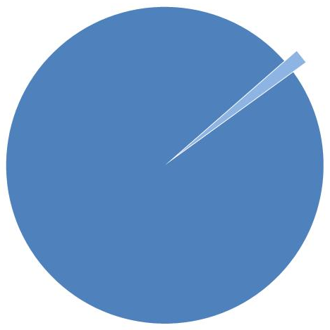
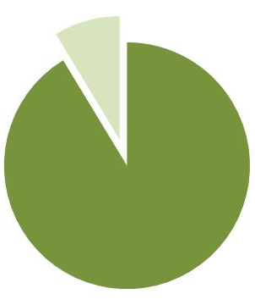
Dodd-Frank Clawback
Recovery Under Clawback Provisions
Dodd-Frank Sarbanes Oxley
$64.6 million $1.19 billion
of $4.4 billion Total Gains (Direct and Indirect)
Notes:
Aggregate gain of over $4.38 billion in Total Gains; Only $64 million from Direct Gains (excess incentive compensation) and the remaining $4.3 billion from stock and option profits.
Dodd-Frank applies to ALL CEOs; SOX applies to limited sub-set of fraud firms. Despite the smaller application, SOX clawback actually recovers quite a bit more ($1.19b vs. $64.6m). This is due almost entirely to stock and option gains.

Slide 42
Results
Effectiveness of Dodd-Frank
  Excess Incentive Compensation
Stock and Option Gains
Probability of Termination

Slide 43
Fired = α + β₁Log(Assets) + β₂Tenure + β₃NI +
β₄Neg_NI + β₅NI_Down + β₆Loss2 + ε
Fired =
Neg_NI =
NI_Down =
Loss2 =
1 if CEO fired (involuntary turnover)
0 otherwise (no turnover or voluntary)
1 if net income is negative
0 otherwise
1 if net income decreased from prior year
0 otherwise
1 if net income is negative for prior two years
0 otherwise
Notes:
18.9% of Turnovers are involuntary (FIRED); 2% of all CEOs are FIRED each fiscal year.

Slide 44
Notes:
ALL CEOs in Execucomp for this regression. Negative relation between net income and fired – the higher the net income, the lower the termination risk. (coefficient is scaled by 10,000)
Marginal effects in brackets

Slide 45
Notes:
Adding indicator variables loses significance for NI, but all three indicator variables are highly significant at the 1% level (with and without FE). Adding FE increases the coefficients.

Slide 46
ΔProb = Prob_{Unrestated} – Prob_{Restated}
Prob_{Restated}
ΔProb < -12.763% → “Termination Avoidance CEOs”
Notes:
Determine change in probability – by how much was CEO able to reduce his prob of termination by manipulationg?
* Unrestated = “manipulated” probability (should be lower b/c manipulate to decrease); Restated = true probability (should be higher)
Average Reduction in Probability of Termination = 12.673%
We find approximately 18% of CEOs in the sample are able to reduce their probability of termination by at least ten percent and nearly 11% of the sample are able to reduce their probability of termination by more than fifty percent as a result of manipulating earnings.

Slide 47
Probability of Termination
Gain from Delayed Termination:
  (ΔTerminationRisk for CEO_{k}) x (CEO_{k} Comp_{t-1}) x (Number of Years)
  Average gain of $22.47 million (per CEO)
  Aggregate gain of $1.55 billion (aggregate)

Slide 48
Robustness
Notes:
* Small Firm Bias?
* We include only firms in Execucomp (S&P 500; S&P Mid-Cap 400; S&P Small-Cap 600)
* Of 1,300 restatements, Exexucomp accounts for only 275. Is there a size bias?
Repeat the analysis; breaking down by index.
Change in net income for S&P 500 is over 17 times larger than change in net income for Mid Cap; over 19 times larger than Small Cap.
Change in Excess Incentive Compensation and Stock/Option Gains for S&P 500 firms roughly 4-8 times larger than for MidCap or Small Cap.
Excluded small firms likely to be similar magnitude of restatement. Excluded smaller firms not likely to bias total dollar gains.

Slide 49
Notes:
Repeat main results; broken down by index. S&P 500 shows similar results to full sample for both DF and SOX.
Marginal improvement for MidCap; not for SmallCap. Thus, if anything, including the smaller firms would likely lead to event rejection of DF effectiveness.

Slide 50
Robustness
Post-Dodd-Frank Period
NEED TO ADD NOTES

Slide 51
Conclusion
Problem: CEOs inflate earnings for personal gain
  Average CEO increases wealth by $18 million as a result of misreporting.
  Only a small portion of Total Gains subject to clawback
  A large portion of CEOs are able to avoid or delay termination by misreporting
Purpose of Section 954: To hold executives accountable by removing incentive to manipulate
Limitations: does not require recovery profits from the sale of stock and option exercises
Notes:
$18 million over misreported period; amount per year is closer to $7.6 million (Table 8)

Slide 52
Conclusion
Result: Dodd-Frank has broad reach but limited application.
  Potential to recover something from 93% of CEOs
  Potential to recover 73% of Direct Gains
  Does not reach Indirect Gains
  Limited recovery of less than 1% of Total Gains
Effectiveness:
  Depends on how vigorously boards willing to purse executives.
    Personal and professional relationships
    Cost of litigation > Amount recoverable

